Slide 1



Git and Git commands

Slide 2

Introduction
Welcome to this comprehensive guide on basic knowledge of Git and some Git commands . In this presentation, we will cover the basics of Git and Github, and provideinformation about some useful commands of Git.

Slide 3


What is Git?
is a distributed version control system that allows developers to track changes in code and collaborate with others. Git provides the ability to work ofﬂine, branch code, and merge changes.

Slide 4

What is Github?
Github is a web-based platform that allows developers to store, collaborate, and manage their Git repositories. Github provides a range of tools for teams to work together and manage code changes.In simple terms, we can say it is hosting service for managing Git repositories

Slide 5
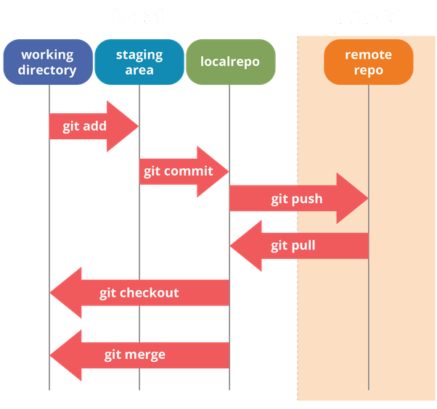
Why Git ?
Effective collaboration
Save time
Track Changes
Undo Mistakes
Git- Three Stage Architecture

Slide 6
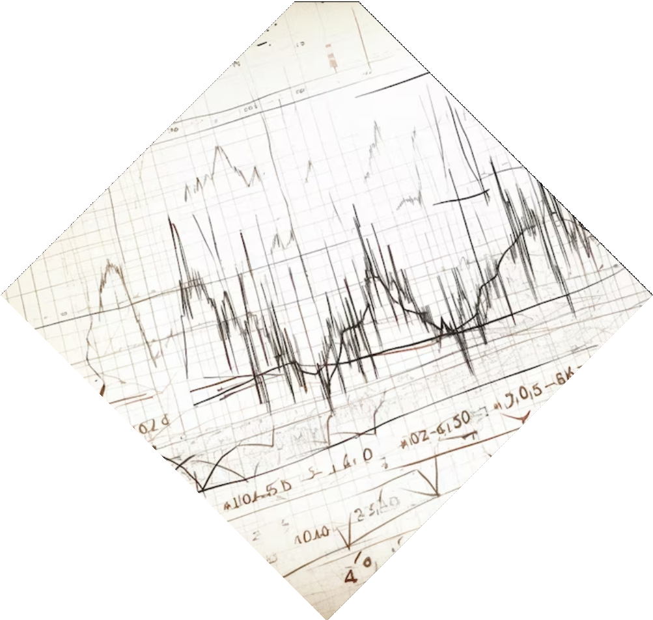
Version Control
Version control is the process of managing changes to code over time. Git make version control easy by allowing developers to track changes, revert to previous versions, and merge changes from multiple sources.

Slide 7
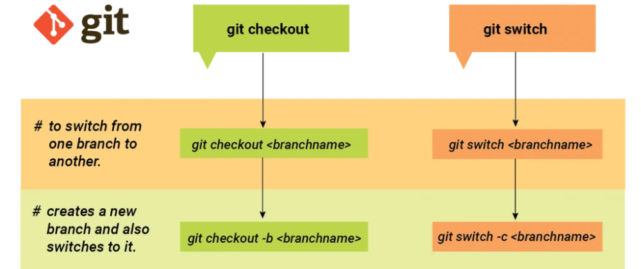
Git Switch
Git Switch is a tool that helps you switch between branches and repositories with ease.
To use Git Switch, ﬁrst, you must install it using the command npm install -g git- switch. Then, you can switch between branches or repositories using the git switch command.
For using Git Switch efficiently you must keeping your branches up to date, using descriptive branch names, and using Git Switch in combination with other Git tools such as Git Flow.

Slide 8
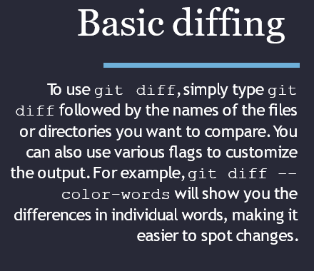
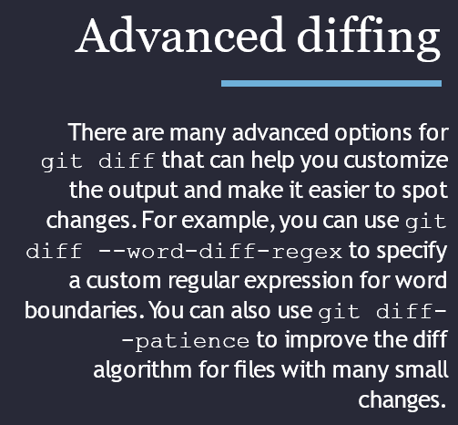
Git diff
git diff is a command that shows the differences between two versions of a ﬁle or directory. With git diff, you can easily see what has changed, who made the changes, and when they were made.

Slide 9

Git Bisect
Git Bisect is a command-line tool that helps developers identify the commit that introduced a bug.
It works by binary searching through the git history to ﬁnd the exact commit that introduced the bug.
Git Bisect perform a binary search through the commit history to ﬁnd the exact commit that introduced the bug.

Slide 10
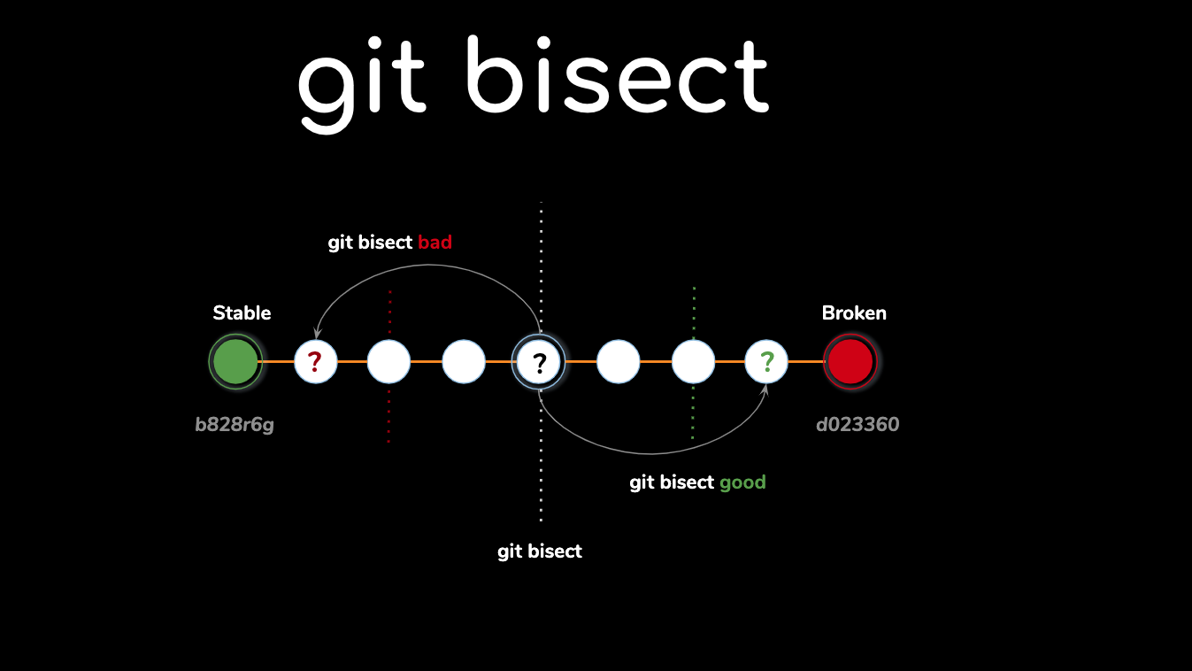
Using Git Bisect
To use Git Bisect, developers must ﬁrst mark a known good and bad commit using git bisect start. They can then test each commit using git
bisect good or git bisect bad, depending on whether the commit is good or bad. Git Bisect will then continue the binary search until it has identiﬁed the commit that introduced the bug.

Slide 11

What is Git Rebase?
Git rebase is a feature that allows you to apply changes from one branch onto another. It is an alternative to Git merge that creates a linear history.
Using Git rebase can provide several beneﬁts, including a cleaner commit history, better collaboration with your team, and easier debugging.
By using Git rebase, you can avoid merge conﬂicts and keep your commit history organized.

Slide 12
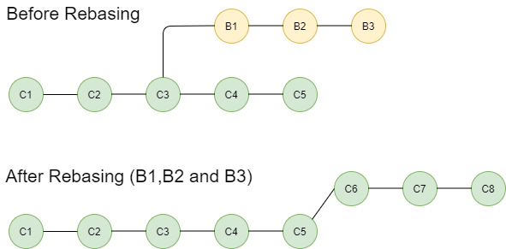
Using Git Rebase
To use Git rebase, you ﬁrst need to identify the branch you want to apply changes to. Then, you can use the git rebase command to apply the changes. You can also use the --
interactive ﬂag to reword, edit, or delete commits during the rebase process.

Slide 13
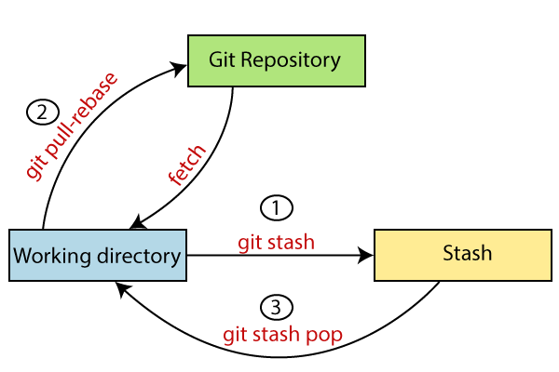
Git Stash
Git Stash is a powerful tool that allows you to save changes you have made to your working directory and switch to another branch without committing those changes.
To stash changes, use the command git stash. This will save your changes and revert your working directory to the last commit. You can then switch to another branch or perform other tasks. To retrieve your stashed changes, use the command git stash apply.

Slide 14
Stash Pop & Stash Branches
The git stash apply command will apply the most recent stash. If you have multiple stashes, use the command git stash list to see a list of your stashes. You can then use the command git stash apply stash@{n} to apply a speciﬁc stash. Alternatively, use git stash pop to apply and remove the most recent stash.
You can also stash changes on a speciﬁc branch by using the command git stash branch <branch-name>.This will create a new branch with your stashed changes and switch to it.

Slide 15
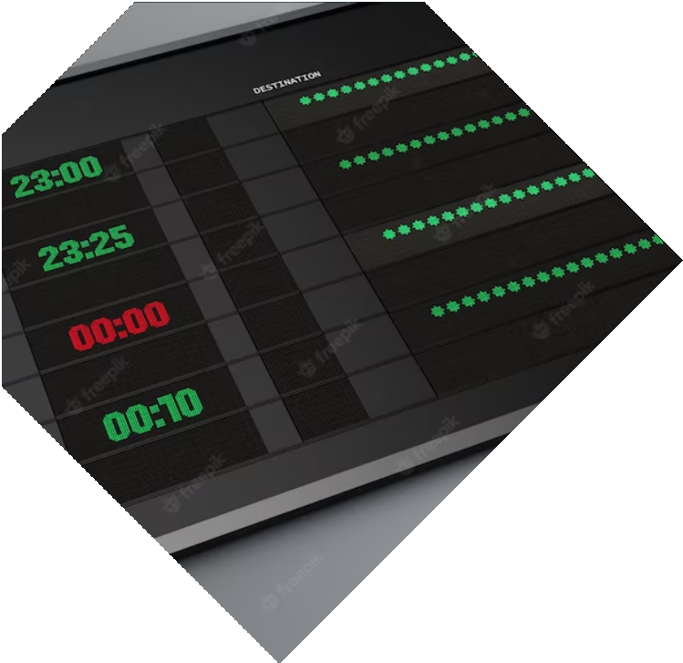

Git Reflog
Git Reﬂog is a command that keeps a record of all changes to the Git repository, including deleted branches and commits. It is a powerful tool for recovering lost changes and undoing mistakes.
By using the git reflog command, you can view a log of all the recent actions and ﬁnd the commit that was lost or deleted.
By using the git reset command with the hash of the previous commit, you can undo changes and restore the repository to a previous state.
Git Reﬂog can be used to manage branching and merging. By keeping a record of all changes, it is easy to see where branches were created and how they were merged. This can help you avoid conﬂicts and ensure a smooth workﬂow.

Slide 16


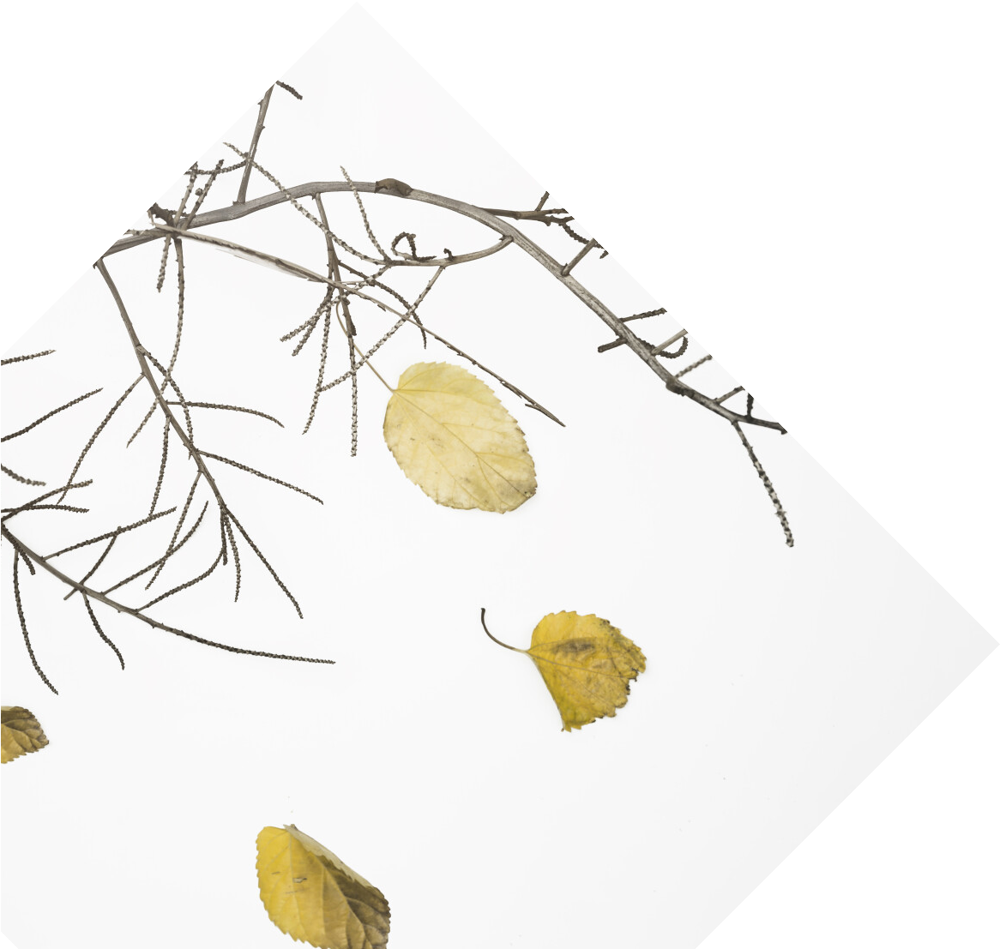
Git Cherry-Pick
Git cherry-pick is a powerful tool that allows you to select and apply speciﬁc commits from one branch to another.
Git cherry-pick is most useful when you want to selectively integrate changes from one branch to another.
For example, if you have a bug ﬁx in one branch that you want to apply to another branch without merging the entire branch. Or if you have a feature branch with multiple commits and you only want to apply certain changes to another branch.
Git cherry-pick gives you the ﬂexibility to choose which changes to apply and which to leave out.

Slide 17

How to Use Git Cherry-Pick
To use Git cherry-pick, you ﬁrst need to identify the commit you want to apply. You can do this using the Git log command. Once you have identiﬁed the commit, you can use the Git cherry-pick command to apply it to another branch. Git cherry-pick will create a new commit with the changes from the selected commit. If there are conﬂicts, Git will prompt you to resolve them.

Slide 18
Conclusion
In conclusion, mastering the fundamentals of Git and Github is essential for effective collaboration and version control. By using these tools, developers can work together seamlessly and create high-quality software.

